Slide 1
RESUSCITATION AND AUTOMATED EXTERNAL DEFIBRILLATION
OLUFOKUNBI AJOKE REBECCA
RN, RM, RICN, BNSc, PDE (TRCN), MPH (Epidemiology), MNSc (in view)

Slide 2
Title and Content Layout with List
Definition of Terms
Principles of Resuscitation
Phases of Cardiopulmonary Resuscitation
Advanced Life Support
Prolonged Life Support
Managing the Cardiac Arrest Team
Equipment used in Resuscitation
Techniques of Resuscitation
Contraindications to CPR
Conclusion
References

Slide 3
PRINCIPLES AND TECHNIQUES
OF RESUSCITATION
Resuscitation is the action or process of reviving someone from unconsciousness or apparent death. It is done either by cardiopulmonary resuscitation or mouth to mouth resuscitation.
Cardiopulmonary resuscitation: Is a techniques of basic life support for the purpose of oxygenation to the heart, lungs and brain until and unless the appropriate medical treatment can come and restore the normal cardiopulmonary function.
Mouth To Mouth Resuscitation: Is a form of artificial ventilation.
It’s the act of assisting or stimulating respiration in which a rescuer presses their mouth against that of victim and blows air into the person’s lungs

Slide 4
CARDIOPULMONARY RESUSCITAION
C- Cardio (Heart)
P – Pulmonary (Lungs)
R – Resuscitation (Recover)
PURPOSE
Restores cardiopulmonary function
Prevents irreversible brain damage from hypoxia
INDICATIONS
Cardiac Arrest
Respiratory Arrest
Combination of both

Slide 5
PHASES OF CARDIOPULMONARY RESUSCITATION
1. Basic Life Support – Circulation
- Airway
- Breathing
2. Advanced Life Support - Drugs
- Electrocardiography
- Fibrillation
3. Prolonged Life Support – Post Resuscitation Care
CHAIN OF SURVIVAL
1. Early recognition and call for help to prevent cardiac arrest
2. Early CPR to buy time
3. Early defibrillation to restart the heart
4. Post resuscitation care to restore quality of life

Slide 6
Early recognition: it is an assessment phase.
VITAL SIGNS: HR < 40b/m or >150 b/ m
: SBP < 80mmHg
: DBP > 120mmHg
: RR > 35 c/m (Adult) > 60 c/m (Child)
Apnoea, Dyspnoea
No pulse felt within 10 secs

Slide 7
EARLY CPR - CHEST COMPRESSION
Place patient on a hard surface
Commence immediately for any patient with absent central pulsations. place the palm of one hand in the concavity of the lower half of the sternum, 2 fingers above the xiphoid process.
The other hand is placed over the hand on the sternum
Shoulders should be positioned directly over the hand with the elbows straight and arms extended. Use your upper body weight to compress
Sternum must be depressed at least 5cm in adults and 2-4cm in children, 1-2cm in infants.
Push hard and fast at 100 – 120 compression per minute.
Compression: ventilation
30:2 in Adult
15:2 in children

Slide 8
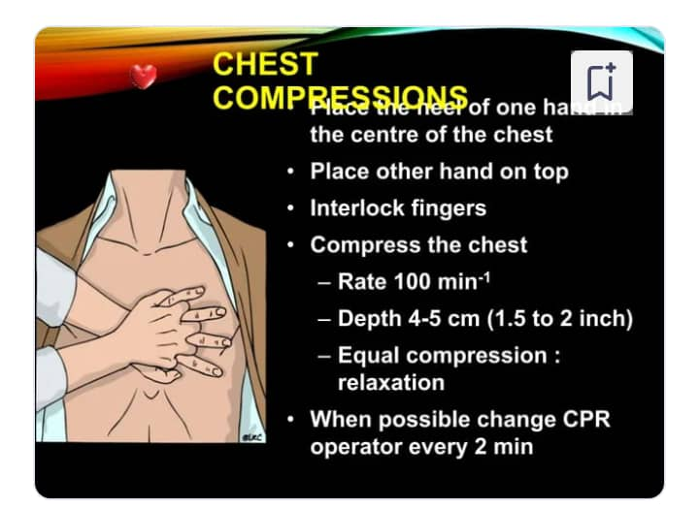
CHEST COMPRESSION

Slide 9
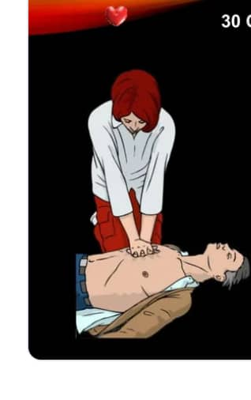

Slide 10
3:1 in Neonates
Compression must not be interrupted in the presence of 2 rescuers.
It must continue for 2 minutes before reassessment of cardiac rhythm.
Ensure high quality chest compressions; Rates, Depth, Recoil.
Plan actions before interrupting CPR.
Early defibrillation of shockable rhythm.

Slide 11
Complications of chest compressions
Rib Fractures
Fracture Sternum
Rib Separation
Pneumothorax
Lung Contusion
Liver Laceration etc

Slide 12
(b) AIRWAY
Loss of consciousness often result in airway obstruction due to loss of tone in the muscles of the airway and falling back of the tongue. Clear the airway by suctioning.
Head tilt, chin lift
Jaw thrust
Insert Guedel Oropharyngeal Airway
Suction the airway

Slide 13
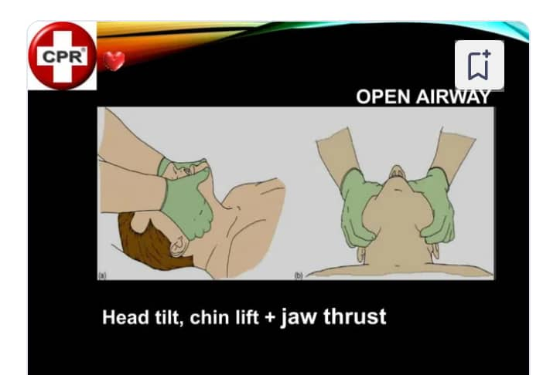

Slide 14
c) BREATHING
Mouth to mouth breathing
Mouth to nose breathing
Mouth to mouth and nose; used in infants and children

Slide 15
SIGNS OF RESTORED VENTILATION AND CIRCULATION
Pupil constriction
Improved colour of the skin
Free movement of chest wall
Swallowing attempts
Struggling movements
Return of strong pulse
Return of systemic BP
WHEN TO TERMINATE RESUSCITATION
Pulse and respiration returns.
Emergency medical help arrives
Physician declares patient deceased

Slide 16
ADVANCED LIFE SUPPORT
It involves:
Circulation by cardiac massage
Airway management by Equipments
Breathing by advanced techniques
Defibrillation by AED
Drugs
Circulation by cardiac massage
Chest compression

Slide 17
Airway Management by Equipments
1. Bag mask device
2. Airway Adjuncts eg Nasopharyngeal airway or Guedel Oropharyngeal airways.
3. Suction machine with Yankeur suction catheter.
4. Oxygen
5. Intubation equipment (several sizes of Endotracheal Tube, Laryngoscope, Stylet, ETCO₂ detection devices, Magil’s forceps, Laryngeal Mask Airway etc)
Advanced Techniques for Breathing
Self inflating resuscitation bag (Ambu Bag)
(a)Expired Air - 16% O₂
(b) Ambu Bag - 21% O₂
(c) Ambu Bag + O₂ (10-15L/M) - 45% O₂
(d) Ambu Bag + O₂ + Reservoir Bag - 85% O₂
Mechanical ventilator

Slide 18
Defibrillation
It is a means of delivering a controlled therapeutic dose of electrical energy [shock] to the heart in order to restore the normal heart rhythm during cardiac arrest with a device called a Defibrillator.
In cardiac arrest, the associated heart rhythms can be categorized into:
Shockable Rhythm: Ventricular Tachycardia [VT]
: Ventricular Fibrillation [VF]
:Pulseless Ventricular Tachycardia [PVT]
Non Shockable Rhythm: Asystole
Placement of Pads
Anterior - Right Infraclavicular Region
Left 5th -6th Intercoastal space anterior axillary line.
Posterior – Left Infrascapular Region
- Left 5th – 6th Intercoastal space anterior axillary line.

Slide 19
Voltage 50J – 360J depending on the Age of the patient, type and duration of arrhythmia.
Performing defibrillation requires proper training and certification.
It is important to remember to stay as calm as possible to be able to carry out procedure properly, prioritizing safety.

Slide 20
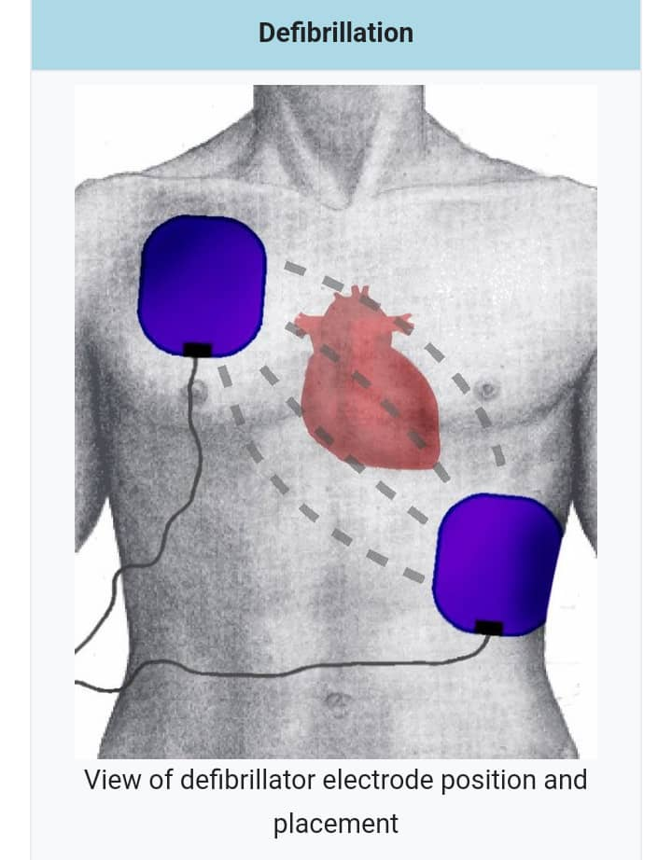
PLACEMENT OF AED PADS/PADDLES

Slide 21
VENTRICULAR TACHYCARDIA
It is a type of irregular heartbeat called an Arrhythmia. A condition in which the lower chamber of the heart beats too fast to pump well and the body doesn't receive enough oxygenated blood. It occurs due to a problem with the heart's electrical impulses. It may develop as a complication of structural heart disease like heart attack, cardiomyopathy, myocarditis, heart valve diseases.

Slide 22
Symptoms are Chest pain, dizziness, syncope, shortness of breath, cardiac arrest.
Treatment
✅ Palliative Care e.g. defibrillation, CPR
✅ Medical Procedure e.g. cardioversion, catheter ablation
✅Device therapy e.g. implantable cardioverter defibrillator
✅ Medication e.g. Antiarrhythmic like Amiodarone

Slide 23
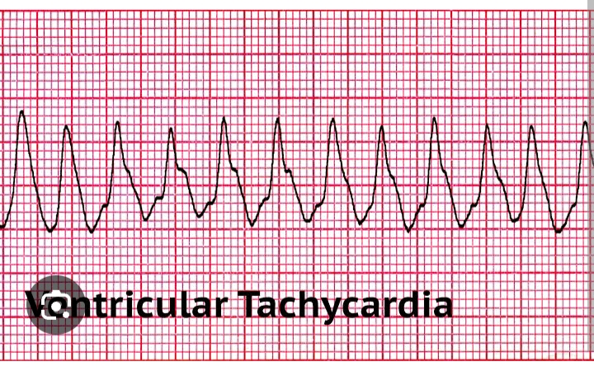

Slide 24
VENTRICULAR FIBRILLATION
The heart is still receiving nerve impulses from the brain. The ventricles are firing erratically ie the ventricles only quiver rather than contract "heart seizure"; the heart has some movement but doesn't actually beat or pump. The shock helps to reset the heart's natural pacemaker (sinoatrial node)

Slide 25
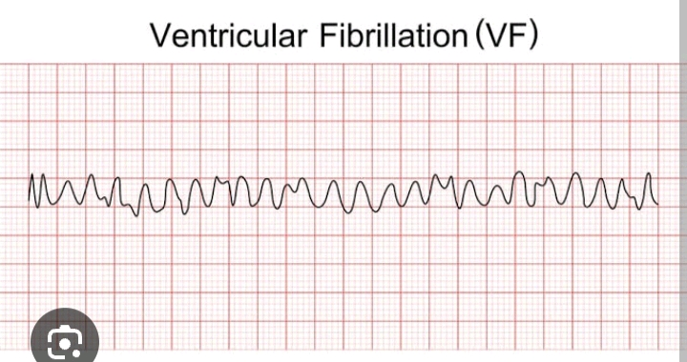

Slide 26
PULSELESS VENTRICULAR TACHYCARDIA
Ventricles pacemakers don't receive impulses from the heart's primary pacemaker and beginning to fire rapidly to compensate. This rapid firing doesn't allow the muscles to contract effectively or the chambers to fill with blood and eventually the patient's pulse cut out.
CAUSES - Coronary artery disease, valvular heart disease, electrolyte imbalances etc.

Slide 27
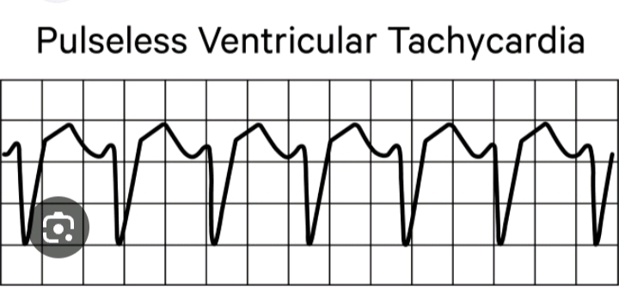

Slide 28
ASYSTOLE
It may occur after a prolonged period of V-fib. Heart is not beating and no longer receiving electrical impulses. ie. Cardiac Flatline. In this situation, the heart rhythm won't respond to a shock and it's highly unlikely that the victim will survive because there is no electrical activity to reset however, high quality CPR and medications to treat the cause can bring back the person.

Slide 29
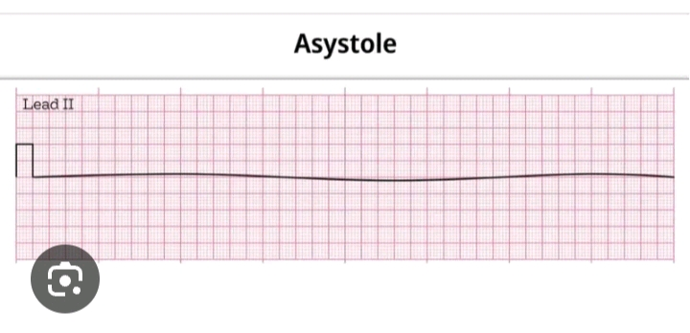

Slide 30
PULSELESS ELECTRIC ACTIVITY
An abnormal rhythm in which the electrical activity of the heart is normal but the ventricles are not responding because there are no problems with the electric signalling. Automaed External Defibrillators can't help. Cardiac arrest in this case could be caused by a problem with the fluid (blood loss) or a problem with the cardiac muscle like tension pneumothorax
ECG shows various rhythms (normal sinus, bradycardia or asystole) but this doesn't correlate with effective heart function .

Slide 31
No pulse, unresponsive, apnoea, cyanosis, dilated pupils because the heart can't generate the mechanical force required for blood circulation
Management
High quality CPR
Secure Airway
Establish IV Access
Give Epinephrine
Continuous monitoring and correct reversible causes (Hs & Ts)
Utilize capnograph to monitor the effectiveness of compression and ventilation

Slide 32
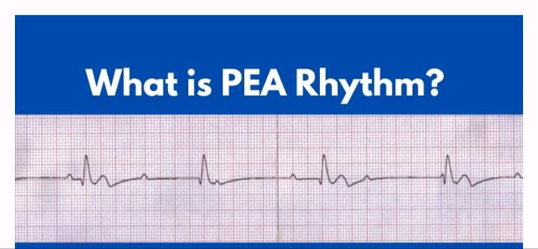

Slide 33
DONT USE AUTOMATED EXTERNAL DEFIBRILLATOR
IF:
✅The victim has a DNR order
✅ The victim is wet or lying in water
✅The patient has a medication patch or pacemaker
✅ The victim has a hairy chest
✅The AED is faulty or has expired parts.

Slide 34
RESUSCITATIVE DRUGS
CARDIAC
Nitroglycerin
Morphine sulphate
Atropine
Epinephrine
Noradrenaline
Dopamine
Dobutamine
Sodium Bicarbonate
ANTI ARRHYTHMIAS
Verapamil
Lidocaine
Amiodarone
Procainamide
Adenosine
NEUROLOGICAL
Mannitol
Prednisolone
Dexamethasone
Hydrocortisone

Slide 35
POISONING
Naloxone – for opiates overdose
Flumazenil – reverses respiratory depression
Atropine – reverses organophosphate poisoning
SHOCK
Treatment depends on the type of shock.
Iv fluids, Blood transfusion, packed Red Blood Cell
HYPERTENSIVE CRISIS
Labetalol
Frusemide
ANTI SEIZURE
Diazepam
Phenytoin

Slide 36
ACID/BASE IMBALANCE
Sodium Bicarbonate
ELECTROLYTE IMBALANCE
Potassium chloride
Calcium Gluconate
Magnesium Sulphate
COAGULOPATHY
Fresh frozen plasma
Platelets
BRONCHODILATORS
Aminophylline
Ipratopium Nebules
Salbutamol Nebules

Slide 37
PROLONGED LIFE SUPPORT
POST RESUSCITATION CARE
Maintain airway and breathing
Check for circulation
Optimizing neurological recovery
Sedation
Control of seizure
Temperature control
Blood Glucose Level

Slide 38
MANAGING THE CARDIAC ARREST TEAM
Team leader should allocate and assign various roles and tasks to the team members.
Airway management and ventilation.
Chest compressions
Iv drug administration
Defibrillation
Timing and documentation

Slide 39
EQUIPMENTS USED IN RESUSCITATION
1. Airway Equipments
Bag Mask Device
Airway Adjuncts eg Oropharyngeal airways. Nasal Prongs, Simple Face Mask, Face Mask with non rebreather bag.
Suction Catheters
Suction Machine
Intubation Equipment eg ETT, Stylet etc

Slide 40
2. Monitoring/Diagnostics
Multiparameter cardiac monitor
Capnograph
Defibrillator with pads
12 lead ECG Electrodes
Ultrasound
Glucometer
3. IV Access
IV Kit with various cannulas, Central Venous Catheter
Arterial Line Kit
IV Pressure Bags
IV Fluids eg Crystalloids, Isotonic etc

Slide 41
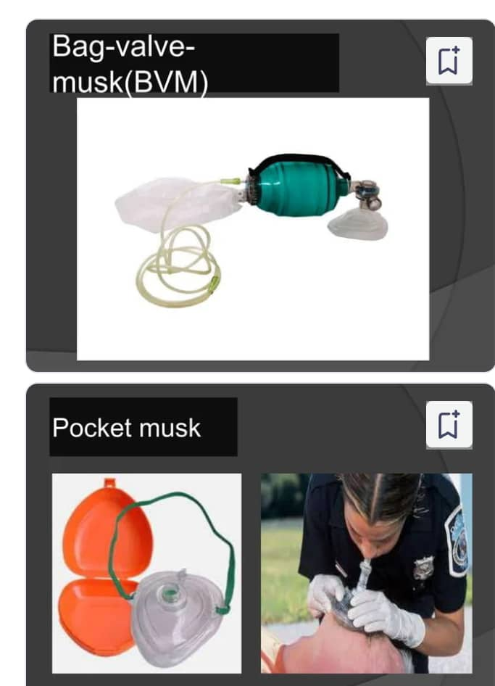
SOME EQUIPMENT USED IN RESUSCITATION

Slide 42
TECHNIQUES OF RESUSCITATION
1. High frequency chest compression: 100-120 compression per minutes.
2. Open chest CPR the heart is accessed through a thoracotomy (created through the 5th intercoastal space) and compression is performed using the thumb and fingers. It generates blood flow and coronary perfusion pressure higher than in closed chest compression. Used majorly in cardiothoracic surgery.
3. Interposed Abdominal Compression CPR it’s a 3 rescuer technique that includes conventional chest compressions combined with alternating abdominal compression the dedicated rescuer who provides manual abdominal compression will compresses the abdomen midway between the xiphoid and umbilicus during the relaxation phase of chest compression. It increases diastolic aortic pressure and venous return resulting in improved coronary perfusion pressure and blood flow to other vital organs.

Slide 43
TECHNIQUES OF RESUSCITATION
4.Cough CPR – the use of forceful voluntary coughs every 1-3secs in conscious patients which increases the intrathoracic pressure and can generate systemic BP higher than those generated by chest compression. It allows patients to maintain consciousness for a brief arrhythmic interval. This is considered in settings such as the cardiac catheterization laboratory for conscious supine and monitored patients.
5. Percussion pacing use of regular rhythmic and forceful percussion of the chest with the rescuer’s fist in an attempt to pace the myocardium.
CONTRAINDICATIONS TO CPR
It is contraindicated in:
Do Not Resuscitate (DNR) order.
If a Clinician justifiably feels that the intervention would be medically futile.

Slide 44
CONCLUSION
CPR is a crucial life – saving treatment that can mean the difference between life and death.
No matter your experience or level of medical understanding, learning CPR is easy and simple and anybody can do it to save a life in an emergency.
We as nurses should know whom to give, when and how to perform, how to assist the procedure.
We should update our knowledge with the new guidelines and perform CPR to save precious lives.

Slide 45
REFERENCES
Chandra N, Weisfeldt ML, Snyder L, Hoffecker M; Augmentation of carotid flow during CPR by ventilation at high airway pressures simultaneous wiyh chest compression. Am J Cardiol 48; 1053, 2020
Fisher J. Vaghaiwallai F, Tsitlik J, Levin H, Brinker J; Determinants and clinical significance of jugular venous valve competence, CIRCULATION 65: 188, 2015.
Guildner CW; Resuscitation – opening the airway : a comparative study of techniques for opening an airway obstructed by the tongue. JACEP 5; 588, 1998
Reddings JS; The chocking controversy. Critique and evidence on the Heimlich maneuver. Critical Care Medicine 7; 475. 2008
Taylor GJ, Rubin R, Tucker M; Importance of prolonged compression during cardiopulmonary resuscitation in man. N. Engl J Med 296; 1515, 2007

Slide 46
THANK YOU FOR LISTENING

