Slide 1

ANTENATAL CARE
ANTENATAL CARE
BY AWONIRAN FLORENCE (RN/RM/BNSC)

Slide 2
INTRODUCTION
The prenatal period is a preparatory one, both physically in terms of fetal growth and maternal adaptation and psychologically in terms of parenthood. Prenatal is a time of intense learning for the parents and for those close to them, as well as a time for development of family unity.

Slide 3
INTRODUCTION
Regular prenatal visits ideally begin soon after the first missed menstrual period, offer opportunities to ensure the health of the expectant mother and her infant.

Slide 4
AIMS OF ANTENATAL CARE
To support and encourage a family's psychological adjustment to childbearing.
To promote an awareness of the sociological aspects of childbearing and rearing and the influences that these may have on the family.

Slide 5
AIMS OF ANTENATAL CARE
To monitor the progress of pregnancy.
To prevent, detect and treat any earliest complications in pregnancy.
To ensure that the woman reaches the term pregnancy physically and emotionally prepared for her delivery.
To motivate the couple about the need for family planning.

Slide 6
OBJECTIVES
To ensure a normal pregnancy with delivery of a heathy baby from a healthy mother.

Slide 7
COMPOSITION OF ANTENATAL CARE
Antenatal care comprises of the following;
Registration of pregnancy
History taking
Antenatal examinations (General and obstetric)
Laboratory investigations
Health education

Slide 8

THE FIRST VISIT
History taking
Examination
investigation

Slide 9
HISTORY TAKING
Patient’s information
Patient’s complaints and duration
Past medical history
Obstetric history

Slide 10
HISTORY TAKING
Menstrual history
Family history
Drug/allergy history
Immunization history
Contraceptive history

Slide 11
EXAMINATION
These include checking the patient’s vital signs;
Heart rate
Respiratory rate
Blood pressure (2 consecutive readings of systolic- 140mmHg, and diastolic- >90)

Slide 12
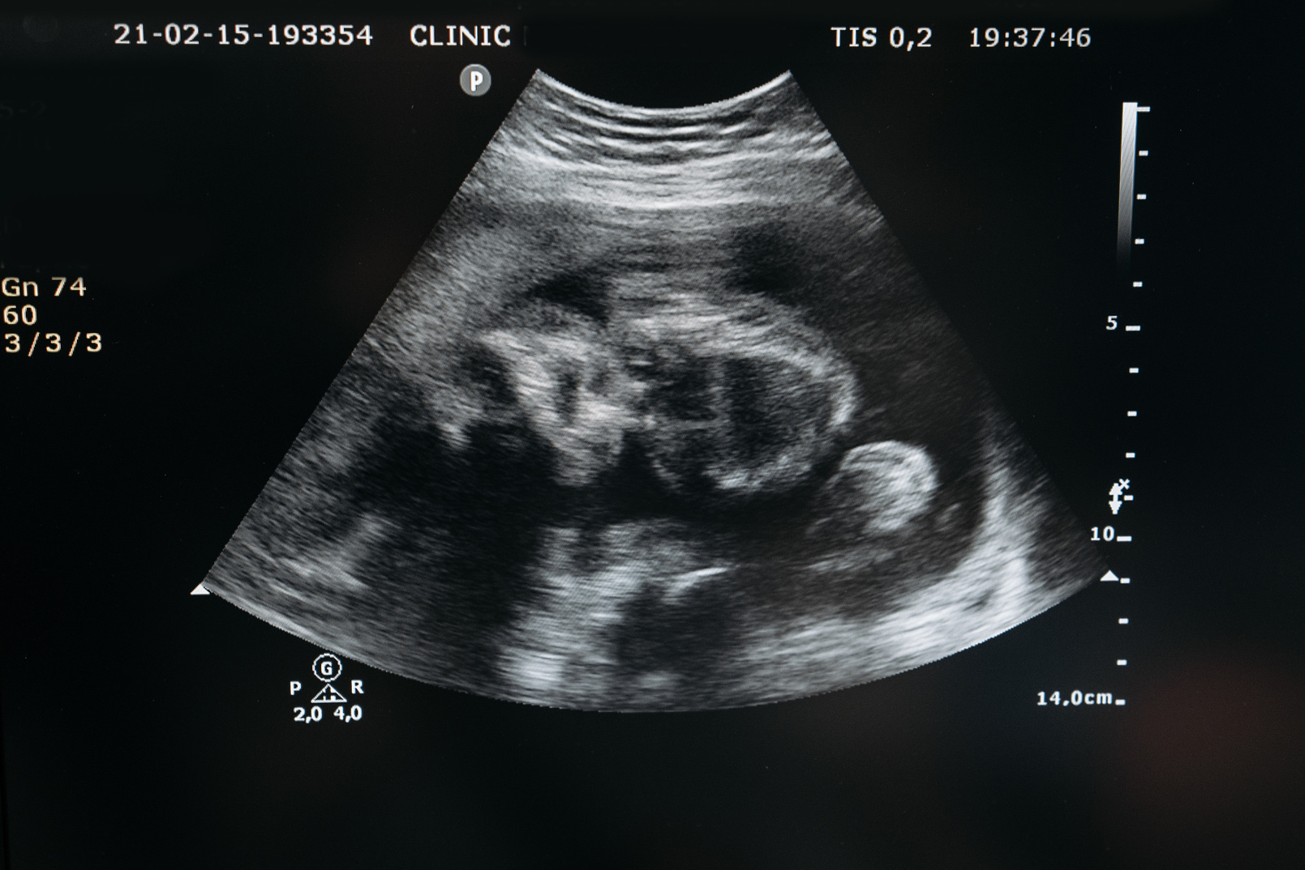
EXAMINATION
Pallor (conjunctiva, nails, tongue, oral mucosa, palms, SpO2)
Edema
Urinalysis blood, albumin
Regular weight check at each visit (11kg for the entire pregnancy)
Breast examination

Slide 13

ABDOMINAL EXAMINATION
Palpation: Fundal height, sound, lie, and presentation
Multiple pregnancy
Inspection of abdominal scar or any other relevant findings

Slide 14
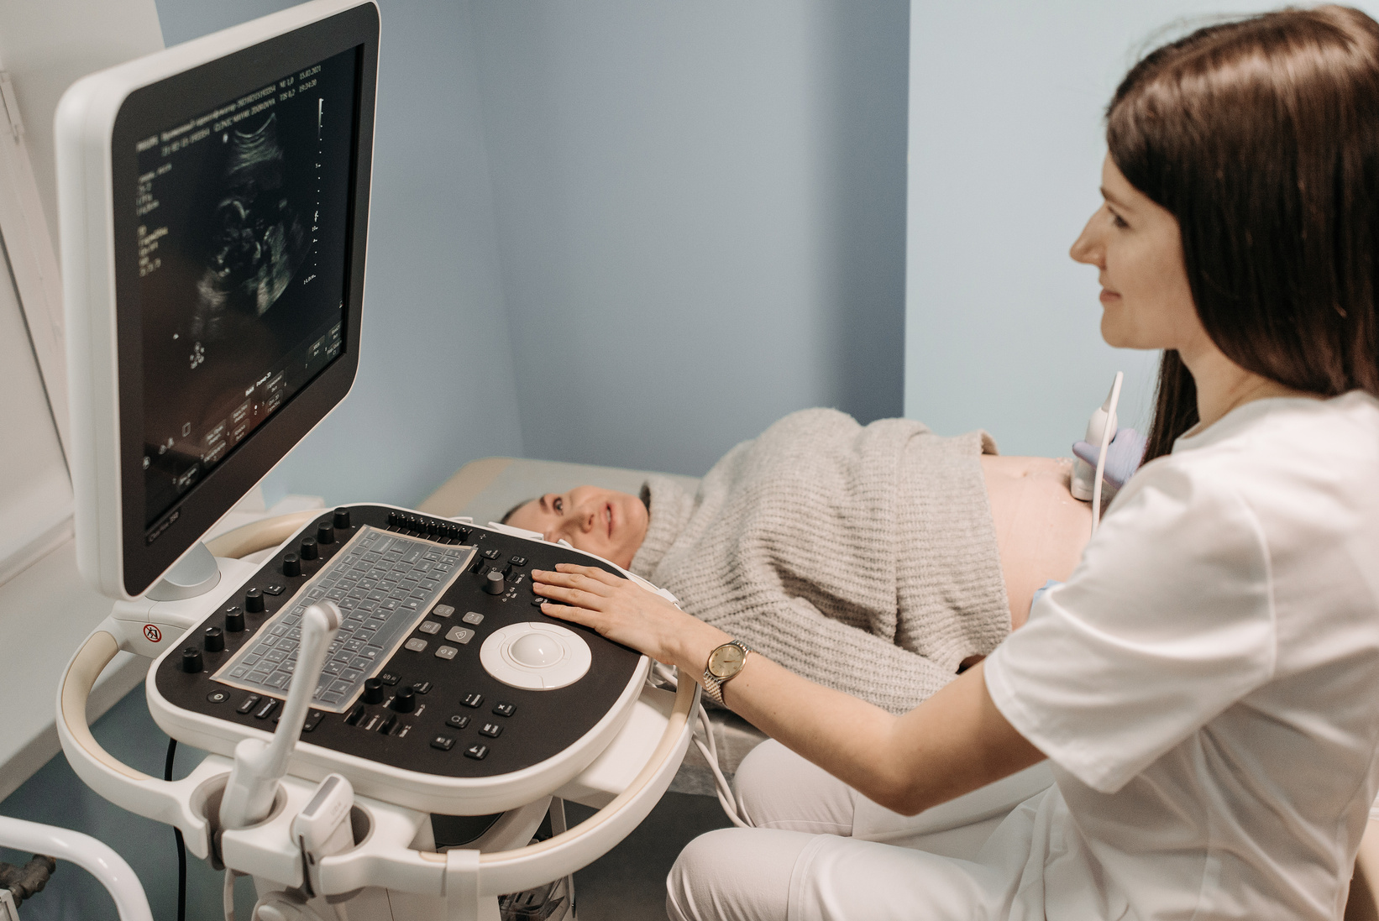
LABORATORY INVESTIGATIONS
Hb estimation
Blood grouping and Rh typing
Urine analysis
VDRL
HIV screening
HBsAg
Ultrasound scan

Slide 15
SUBSEQUENT VISITS
General examination
Palpation and calculation of gestational age
Identification and treatment of problems to prevent complications such as; anaemia, IUFD, pre eclampsia and eclampsia

Slide 16

SUBSEQUENT VISITS
Health education
Prophylaxis and treatment of anemia
Development of individualized birth plan

Slide 17
DIET/HYGIENE/BOWEL CARE
Supplementary iron therapy is needed for all pregnant mothers from 20 weeks onwards.
Daily bath is recommended
Food and environmental hygiene is crucial

Slide 18
DIET/HYGIENE/BOWEL CARE
Wash the breast with clean tap water
Regular bowel movement may be facilitated by regulation of diets, take fluids, vegetables and milk.
Avoid alcohol, smoking, substance use , and any unprescribed drugs because it may be teratogenic.

Slide 19
EXERCISE/DRESSING/REST AND SLEEP
Walk in moderation
Avoid lifting heavy objects
Avoid prolong standing
Avoid sitting with crossed legs
Avoid tight clothes and belts. Encourage loose or comfortable clothing

Slide 20
EXERCISE/DRESSING/REST AND SLEEP
Avoid tight clothes and belts. Encourage loose or comfortable clothing
Avoid high heel shoes
Encourage 8 hours sleep at night, and 2 hours sleep during the day. Avoid strenuous exercise in the first and last 4 weeks.

Slide 21
WARNING SIGN
Headache
Blurry vision
Convulsion
Vaginal bleeding
Fever

Slide 22
SUMMARY
Antenatal care is crucial in all stages of pregnancy till delivery to promote the wellbeing of the infant and the mother.

Slide 23
ANTENATAL CARE
THANK YOU

